Slide 1
Voting: how to register and cast your vote

Slide 2
VOTING OVERVIEW
Register
Research your ballot
Cast your vote!

Slide 3
Step one: Register
How long does it take to register?

Slide 4


Slide 5
How to Register
Register to vote online at vote.virginia.gov
You will need your social security number
Register by mail
Download a paper form from vote.virginia.gov

Slide 6
About the next election
Election Date | Locality and office / Issue | Voter Deadlines
11/5/19 | November General and Special Elections Current list of Special Elections in November | Deadline to register to vote, or update an existing registration, is Tuesday, October 15, 2019. Deadline to request an absentee ballot to be mailed to you is Tuesday, October 29, 2019. Your request must be received by your Registrar by 5:00 p.m. Deadline to vote in-person absentee is Saturday, November 2, 2019

Slide 7
Step TWO: what’s on your ballot?

Slide 8
What’s on your ballot?
See PVCC’s Non-partisan Voter Guide
Released at the end of October every year

Slide 9
There are other resources to help you figure out what is on your ballot!
One resource is BallotReady: a digital nonpartisan voter guide for every race and referendum with a mission to make it easy to cast an informed vote every election.
Another is Ballotpedia
Both websites allow you to search candidate positions, save your picks, and print/send to your e-mail.

Slide 10
Step Three:
Cast your vote!

Slide 11

How to vote…
You can vote:
  In Person on Election Day
  Or by Absentee ballot
Information about where to vote, poll hours, and
  Voter id, and absentee voting can be found at:
    www.vote.virginia.gov

Slide 12
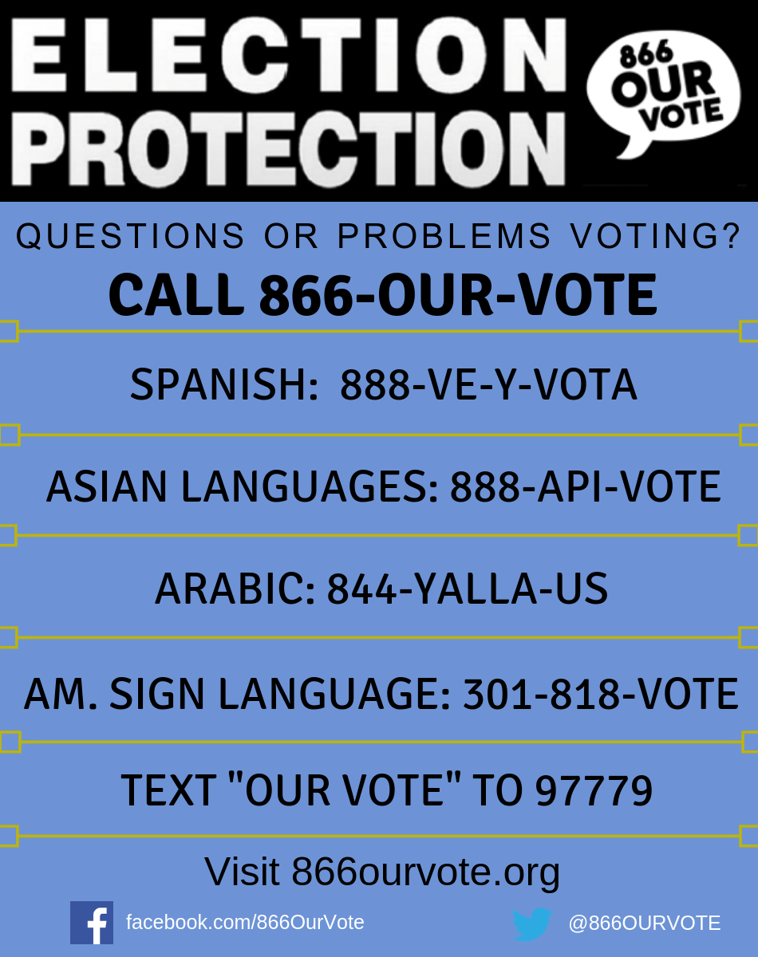
Encounter any issues voting?
There are hotlines to support you.

Slide 13

More resources:
All In to Vote: an all-in-one, nonpartisan, online resource that educates students on how to register, how to be prepared, and how to vote. Students take a pledge to vote and then follow the step-by-step guide to following through on their intention to cast a ballot.
Campus Vote Project: state-specific guides to help students understand how to register and cast a ballot in their school or home community.

